Slide 1
Project Planning and Control
Main issues:
How to plan a project?
How to control it?
Notes:
© SE, Planning and control, Hans van Vliet

Slide 2
System’s view of project control
Irregular variables: cannot be controlled (e.g. experience of the user)
Goal variables: things one wants to achieve (e.g. minimize downtime, lowest cost)
Control variables: things that can be varied (e.g. project staffing, tools to be used)
Distribution of variables over categories is not rigid (staffing may be irregular, cost can be a control variable, etc)
You have to know the category of each variable
SE, Cost planning and control, Hans van Vliet, ©2008

Slide 3
System’s view of project control, conditions
Goals of the system are known
Sufficient control variety
Information on state, input and output of the system
Conceptual control model: knowledge of how and extent to which variables depend on and influence each other
SE, Cost planning and control, Hans van Vliet, ©2008

Slide 4
Classes of project characteristics
Product, process, and resource characteristics
Interested in degree of certainty
Product certainty:
  Clear requirements, known upfront: product certainty is high
  User requirements change frequently: product certainty is low
Process certainty:
  E.g., much knowledge about effect of control actions: high
  E.g., use of unknown tools: low
Resource certainty:
  Depends on availability of appropriately qualified personnel
SE, Cost planning and control, Hans van Vliet, ©2008

Slide 5
Archetypical control situations
Realization problem: all certainties are high
  Ideal situation, just make sure work gets done
Allocation problem: resource certainty low, others high
  Major issue: controlling capacity
Design problem: product certainty high, others low
  How to design the project (milestones, personnel, assign responsibilities, etc)
Exploration problem: all certainties low
  Major issue: get commitment of all people involved
SE, Cost planning and control, Hans van Vliet, ©2008

Slide 6

Control situation: realization
Primary goal in control:
  Optimize resource usage, efficiency and schedule
Coordination/management style:
  Standardization, hierarchy, separation style
Development strategy:
  Waterfall
Cost estimation:
  Models, guard process
SE, Cost planning and control, Hans van Vliet, ©2008

Slide 7
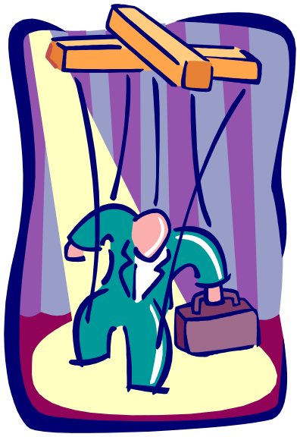
Control situation: allocation
Primary goal in control:
  Acquisition, training personnel
Coordination/management style:
  Standardization of product and process
Development strategy:
  Waterfall
Cost estimation:
  Models, sensitivity analysis
SE, Cost planning and control, Hans van Vliet, ©2008

Slide 8

Control situation: design
Primary goal in control:
  Control of process
Coordination/management style:
  Standardization of process
Development strategy:
  Incremental
Cost estimation:
  Expert, sensitivity analysis
SE, Cost planning and control, Hans van Vliet, ©2008

Slide 9

Control situation: exploration
Primary goal in control:
  Maximize results, lower risks
Coordination/management style:
  Mutual adjustment, commitment, relation style
Development strategy:
  Incremental, prototyping, agile
Cost estimation:
  Agile, risk analysis, provide guidance
SE, Cost planning and control, Hans van Vliet, ©2008

Slide 10

Risk management
Risk management is project management for adults
In software development, we tend to ignore risks:
  We’ll solve the problem on time
  Requirements will be stable
  No one will leave the project
  …
SE, Cost planning and control, Hans van Vliet, ©2008

Slide 11

Top ten risk factors
Personnel shortfall
Unrealistic schedule/budget
Wrong functionality
Wrong user interface
Goldplating
Requirements volatility
Bad external components
Bad external tasks
Real-time shortfalls
Capability shortfalls
SE, Cost planning and control, Hans van Vliet, ©2008

Slide 12
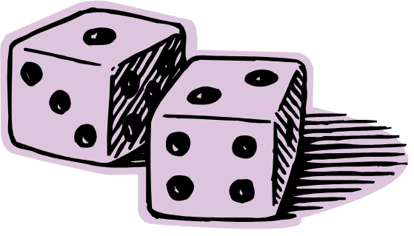
Risk management strategy
Identify risk factors
Determine risk exposure (probability * effect)
Develop strategies to mitigate risks
  Avoid, transfer, or accept
Handle risks
SE, Cost planning and control, Hans van Vliet, ©2008

Slide 13
Categories of risks
Level of control
low
high
customers and users
(C1)
scope and requirements
(C2)
low
Importance
environment
(C4)
execution
(C3)
high
Order of handling: first C3, then C2, then C4 and C1
SE, Cost planning and control, Hans van Vliet, ©2008

Slide 14
Techniques for project planning and control
Work breakdown structure (WBS)
PERT chart
Gantt chart
Agile planning and control
SE, Cost planning and control, Hans van Vliet, ©2008

Slide 15
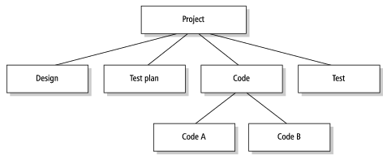
Work Breakdown Structure
SE, Cost planning and control, Hans van Vliet, ©2008

Slide 16
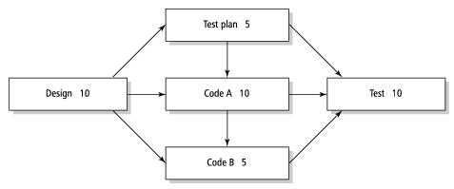
PERT chart
SE, Cost planning and control, Hans van Vliet, ©2008

Slide 17
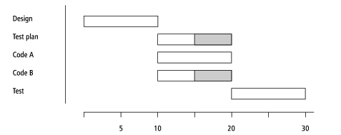
Gantt chart
SE, Cost planning and control, Hans van Vliet, ©2008

Slide 18
Why task-oriented planning is problematic
Activities never finish early
  Parkinson’s law: work fills the time available
Lateness is passed down the schedule
  If either design or coding is late, subsequent testing will be late
Tasks are not independent
  If design takes more time, so will implementation
SE, Cost planning and control, Hans van Vliet, ©2008

Slide 19

Agile planning factors
Estimate value of features
  e.g. the MoSCoW way
Cost of implementing features
  Cost of doing it now versus cost of doing it later
New knowledge acquired
  First do features that bring a lot of new knowledge
Risk removed by implementing feature
  First high-value-low risk features, then low risk-low value features
  Avoid high value-high risk features
SE, Cost planning and control, Hans van Vliet, ©2008

